Slide 1

A glance at Internet topology
Romain Fontugne IIJ Research Laboratory
TechTrend Talk Series vol.2
2023-05-30

Slide 2


Slide 3
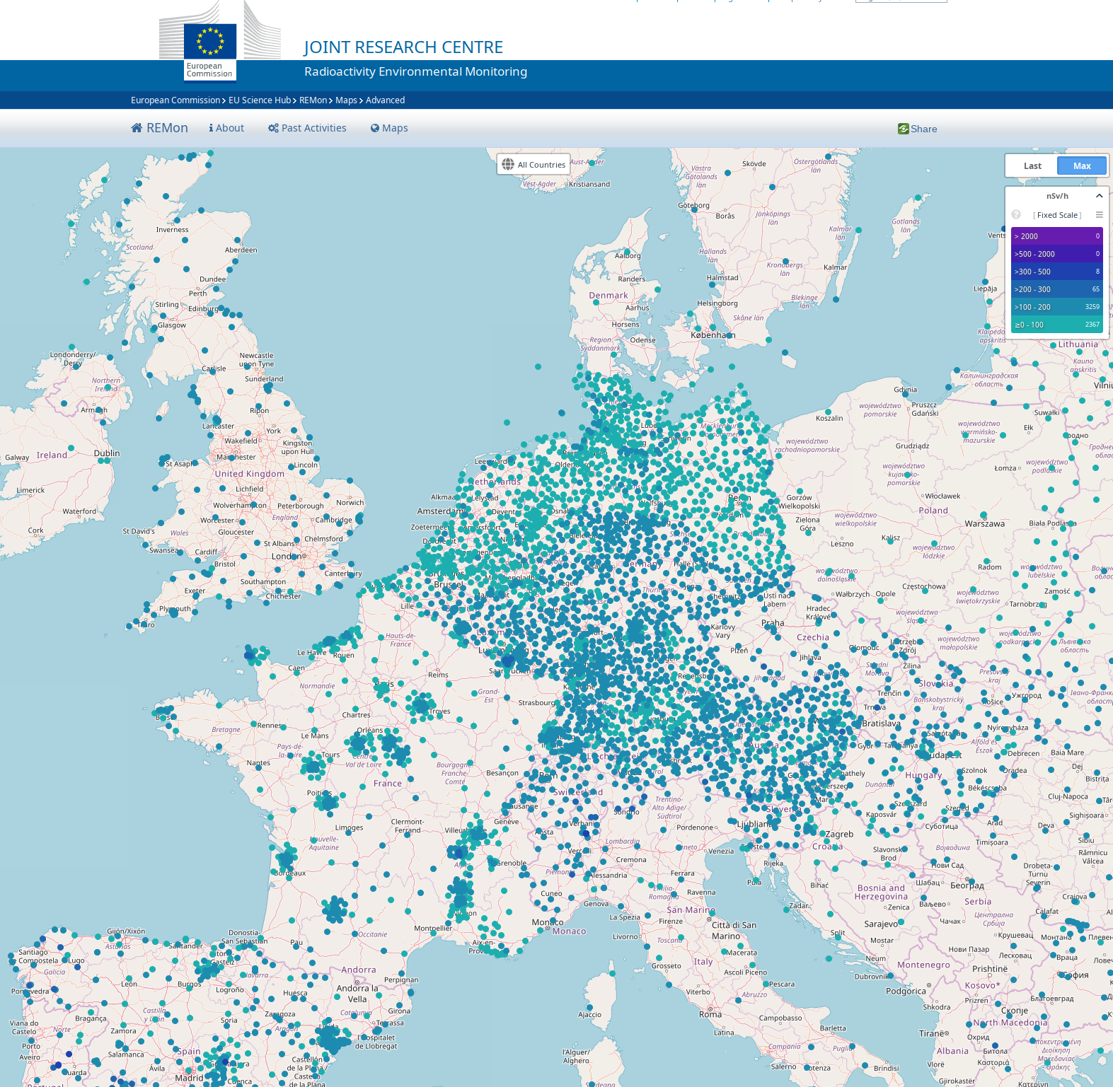
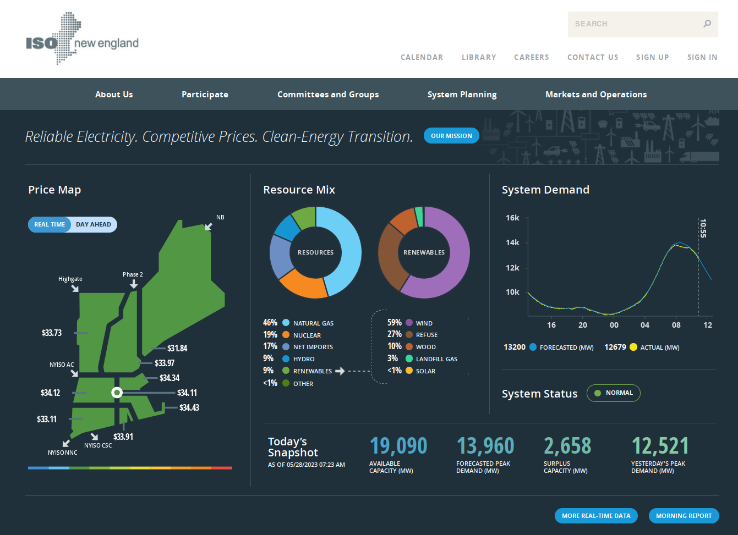
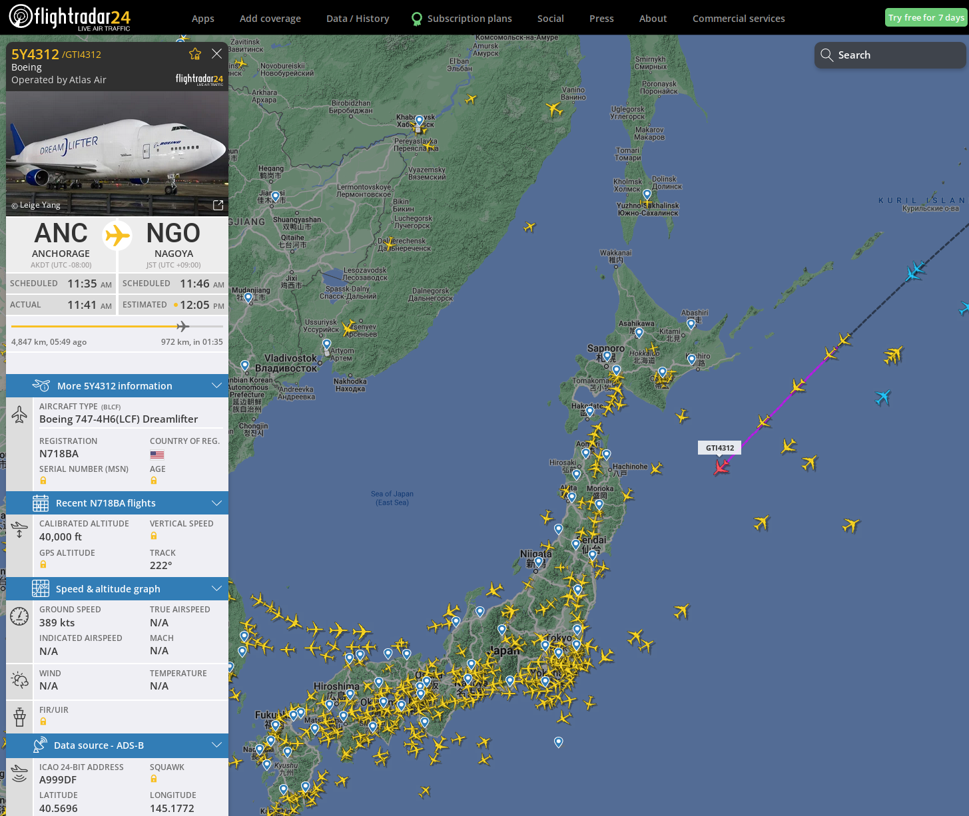
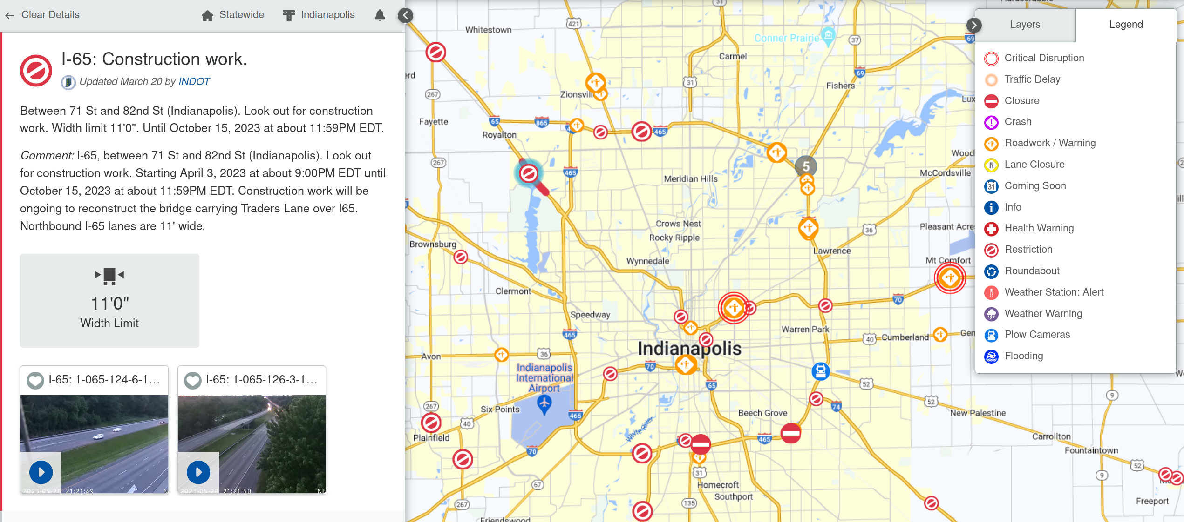
Monitoring
https://www.iso-ne.com/
https://www.flightradar24.com
https://remap.jrc.ec.europa.eu/Advanced.aspx
https://511in.org/event/

Slide 4
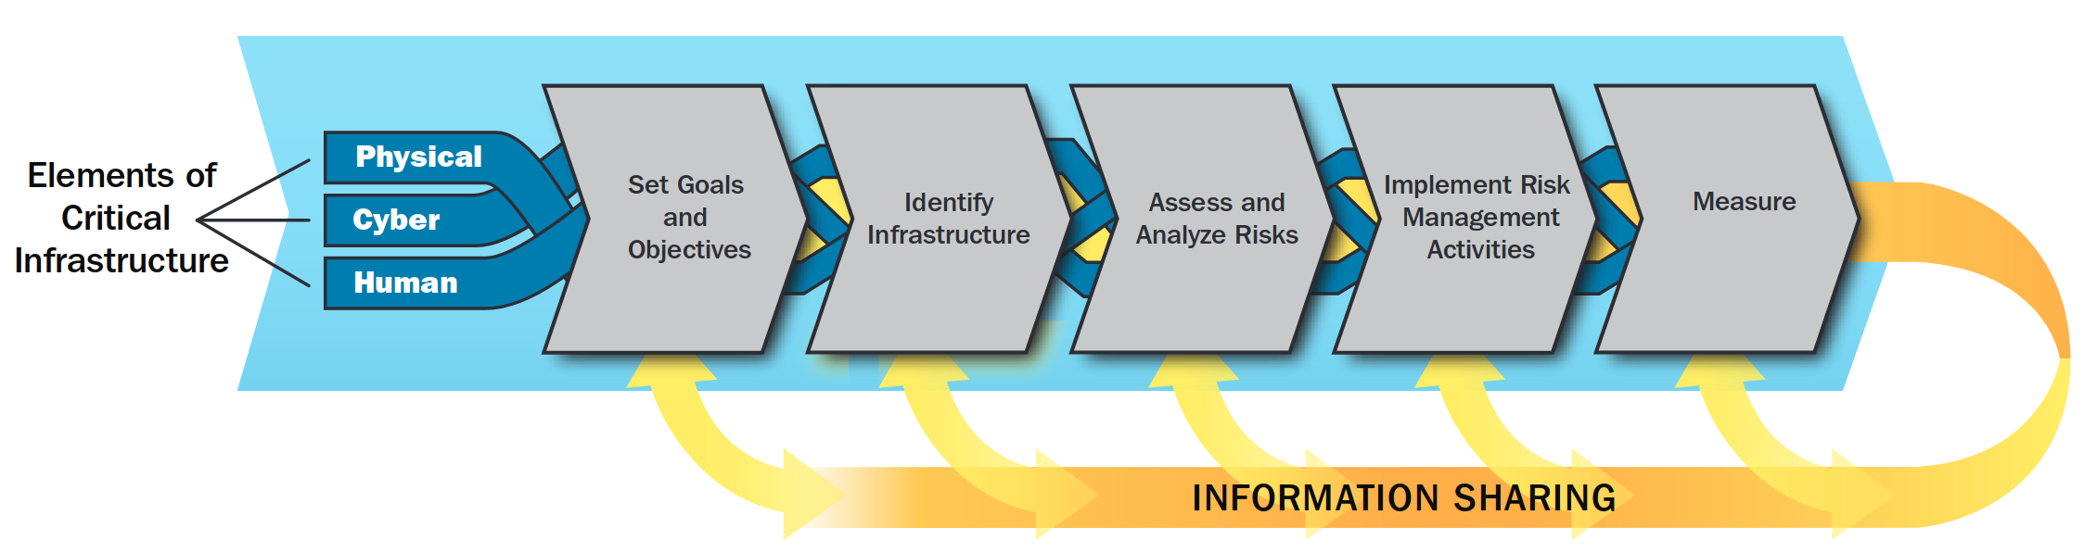
Risk management
Evaluate and Plan

Slide 5
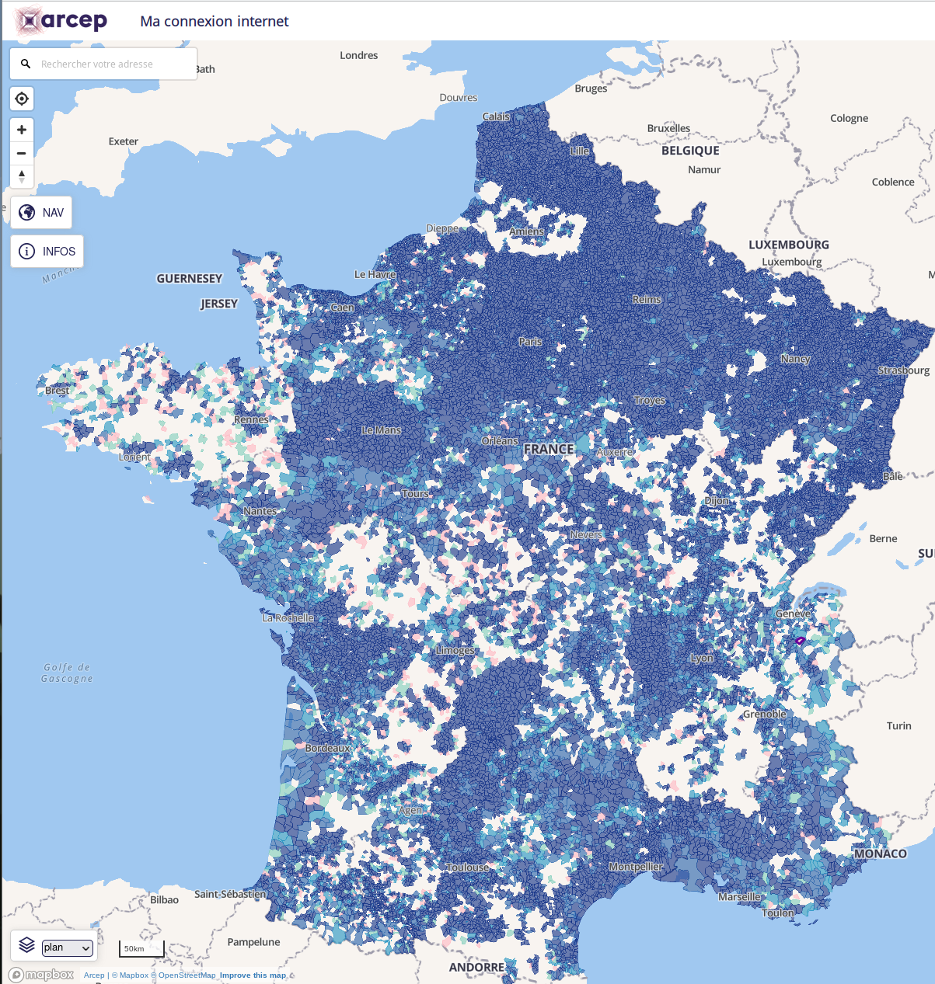
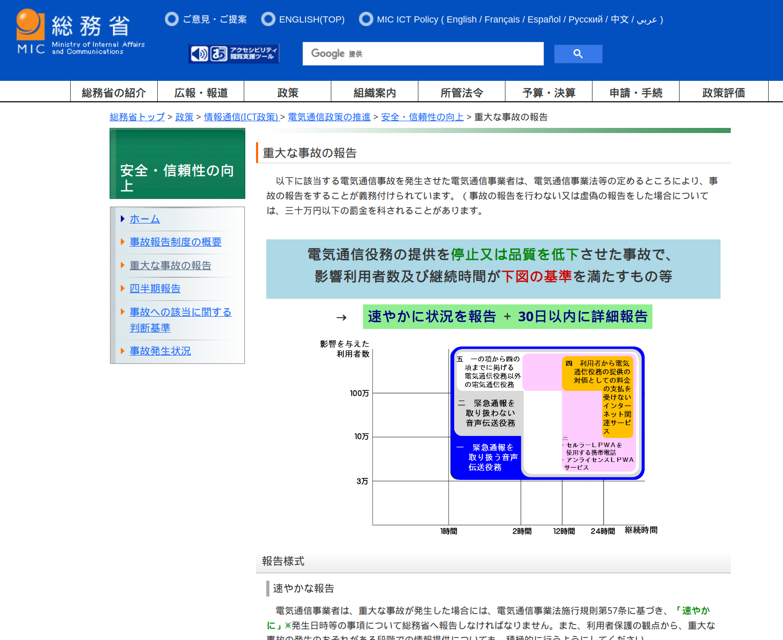
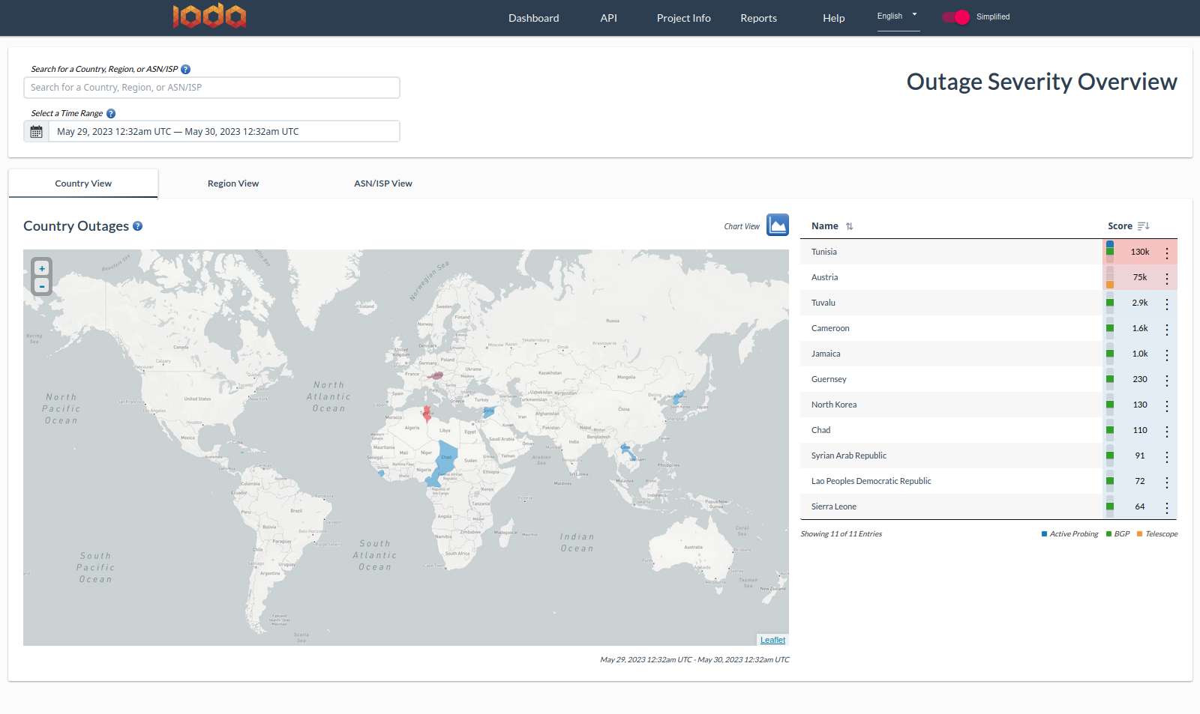
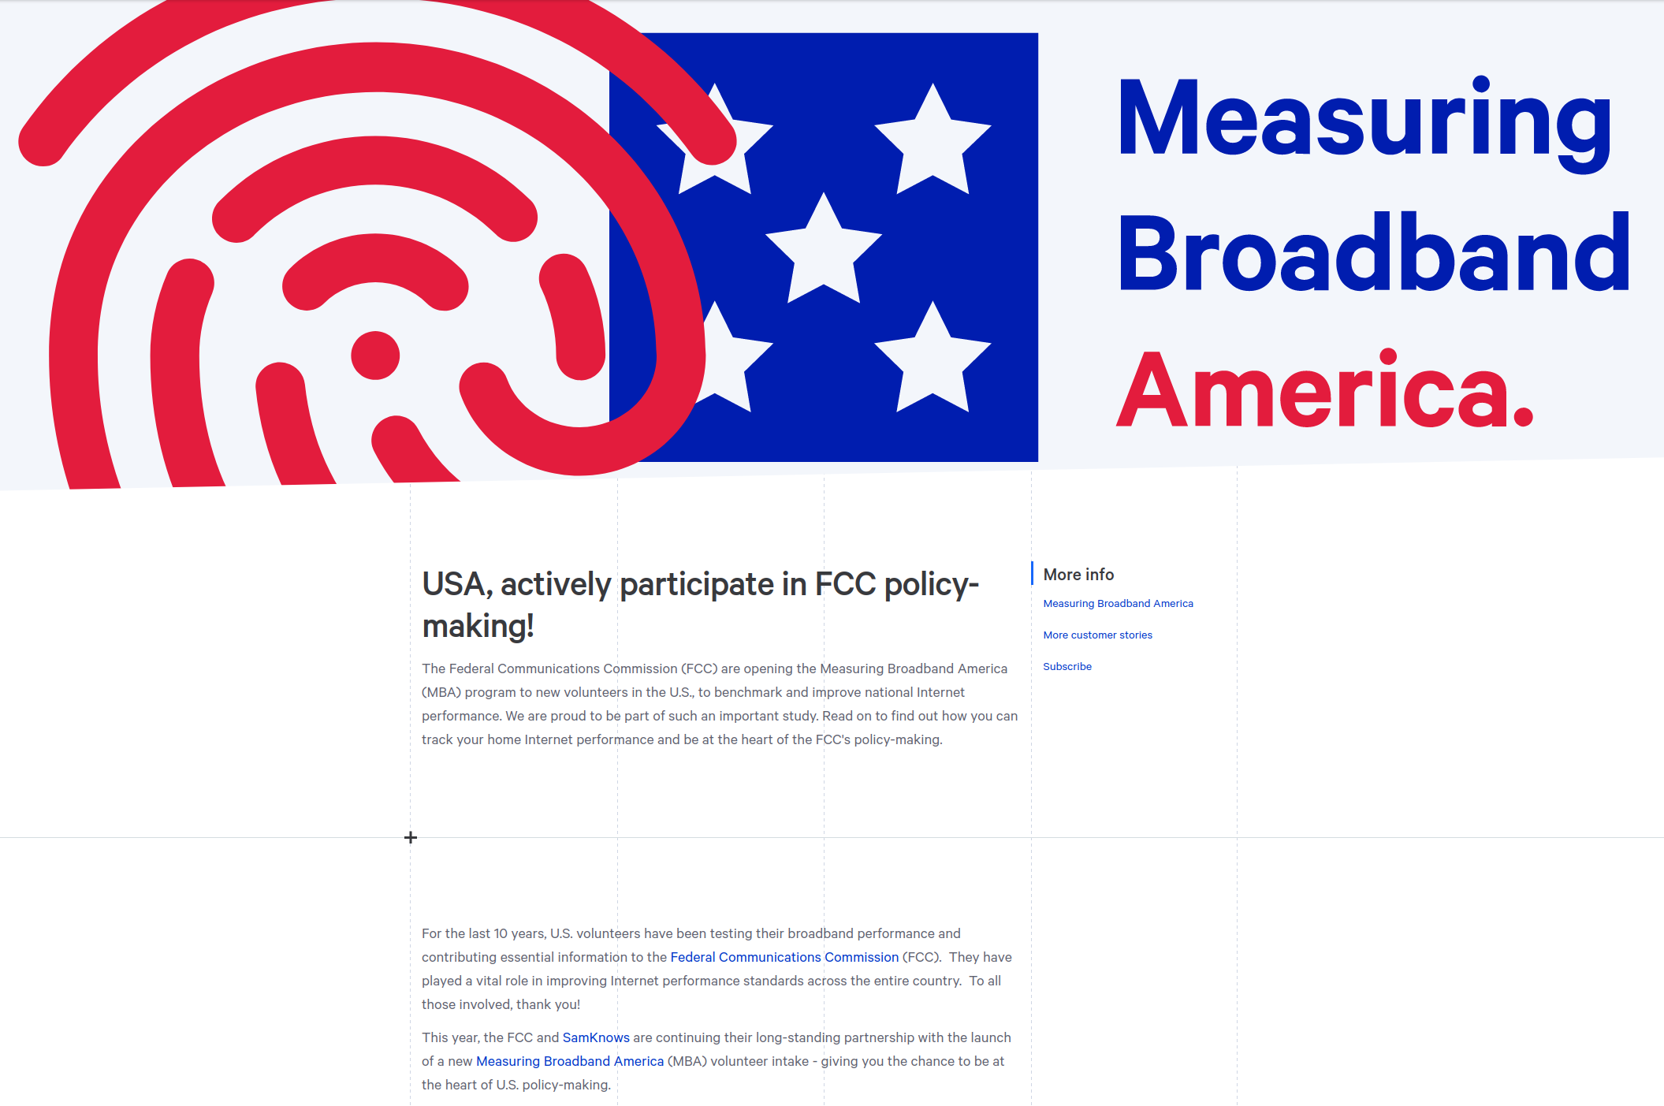
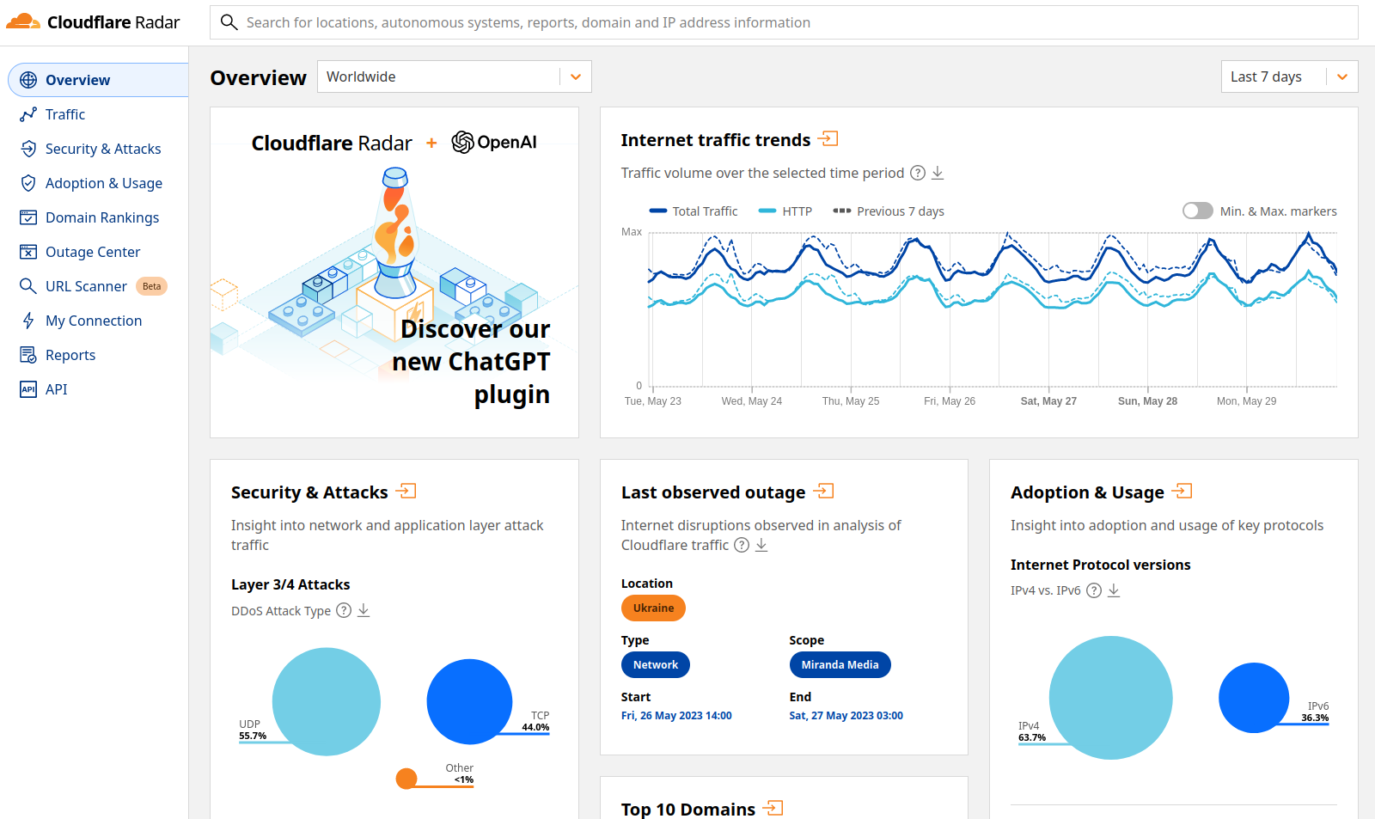
Internet?
https://ioda.live
https://www.soumu.go.jp/menu_seisaku/ictseisaku/net_anzen/jiko/judai.html
https://cartefibre.arcep.fr
RIPE stats
NOGs
Kentik
NetBlocks
Downdetector?
Twitter?
...
https://radar.cloudflare.com/
https://www.fcc.gov/general/measuring-broadband-america-open-methodology

Slide 6
Challenges
Internet is global
Diverse
Unpredictable
Virtual/Cyber-space
Borders?
Hard to breakdown into regions
75k ASes
ISPs, CDNs, Cloud, enterprises, universities, etc...
Infra / net. / web
Obscure parts (Overlay, CGNAT, mobile)
What to measure?
Constantly evolving
Quick global changes
Overlay networks
A lot of dependencies
Hard to get 'insider' data
Not well instrumented

Slide 7
Internet health report
An observatory for the Internet​
Intelligence
Reporting
Collaboration
Assessing the current topology, understanding role of resources, evaluating risks.
​Network dependency
Internet Yellow Pages
RPKI
Detect substantial changes, document disruptive events.
Delay changes
Routing anomalies
Outages​​​
Open source & data
https://github.com/InternetHealthReport
https://ihr.iijlab.net

Slide 8
Network Dependency
Internet
IIJ
HE
Sinet
Measure AS inter-dependencies
• Using BGP data
• Give a good idea of the 'topological location' of ASes
• Customers of an AS
• Example: https://ihr.iijlab.net/ihr/en-us/networks/AS2501
UT

Slide 9
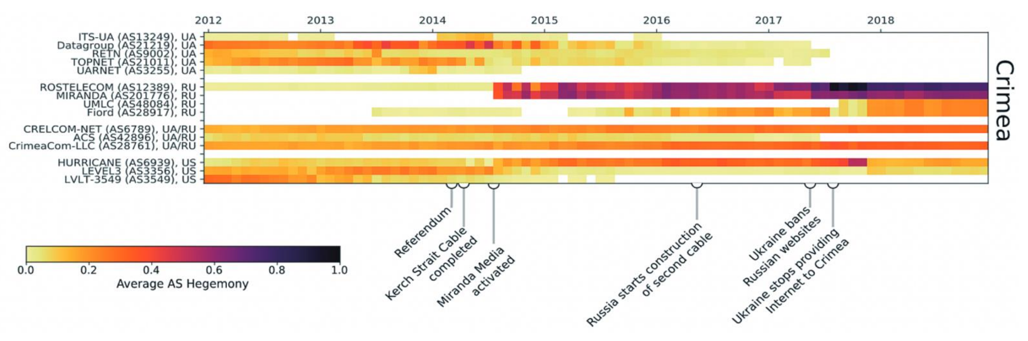
Network Dependency Variants
Crimea
Crimea
Same idea applied differently:
• Regional bottleneck (e.g. Crimea) Outage last Saturday: https://twitter.com/netblocks/status/1662213522263011330
• Countries' network dependency / Resilience (ISOC Pulse) https://ihr.iijlab.net/ihr/en-us/countries/JP https://pulse.internetsociety.org/blog/italys-internet-outage-a-perfect-storm
• 'Customer cone', BGP leak/hijacks, routing anomalies, AS ranking, outages Rogers outage: https://twitter.com/ihr_alerts/status/1545789981603823616

Slide 10
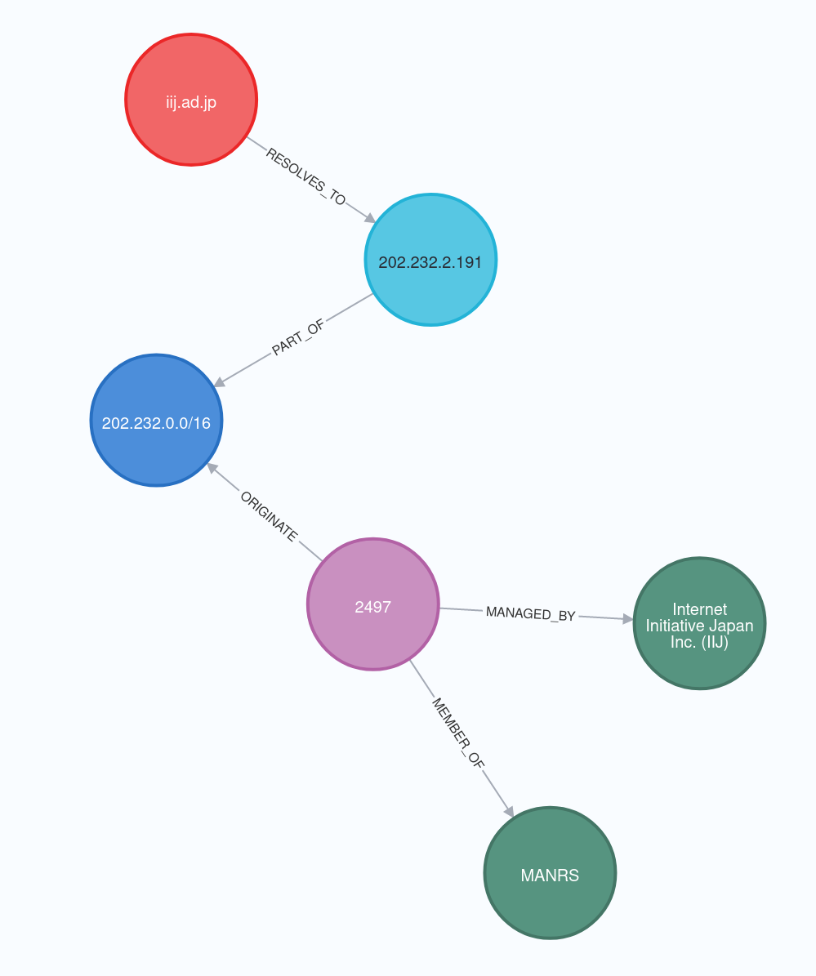
Internet yellow pages
• Knowledge graph for networking data
• 16 data sources:
APNIC, BGPKIT, Bgp.tools, CAIDA, Citizen Lab, Cloudflare, IHR, InetIntel, MANRS, NRO, OpenINTEL, PCH, PeeringDB, RIPE NCC, Stanford, Tranco
• Add semantics to the data
• About 4M nodes, 20M links
• http://iyp.iijlab.net

Slide 11
IYP: demo
Popular .jp domain names
And those not in RPKI
Resiliency of top japanese networks (IXP & facilities)

Slide 12
Conclusion
Internet needs better monitoring
IHR: An observatory for the Internet
Understanding current Internet
Monitoring important changes
Still a lot of work to do on reporting and upper layers
References:
Website: http://ihr.live http://iyp.iijlab.net
Github: https://github.com/InternetHealthReport
@ihr_alerts
romain@iij.ad.jp

Slide 13
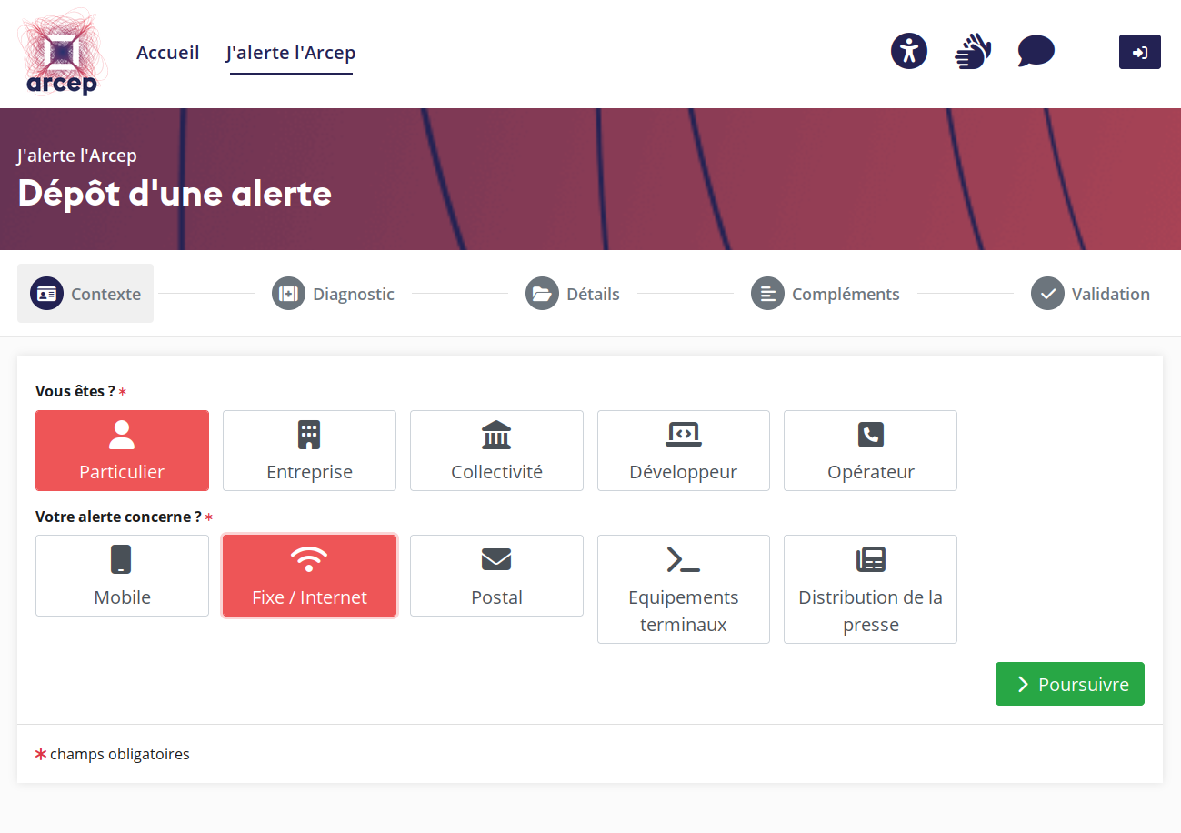
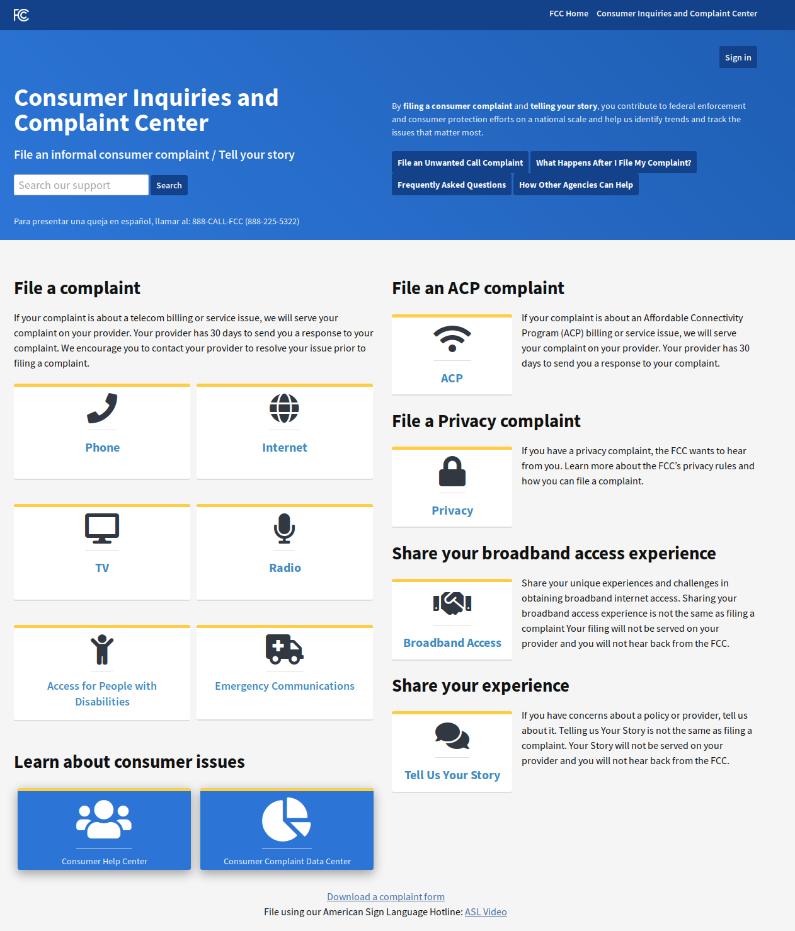
Internet?
https://www.soumu.go.jp/menu_seisaku/ictseisaku/net_anzen/jiko/judai.html
https://jalerte.arcep.fr
IODA
Cloudflare Radar
RIPE stats
NOGs
Kentik
Downdetector?
Twitter?
...
https://consumercomplaints.fcc.gov
https://cartefibre.arcep.fr

Slide 14

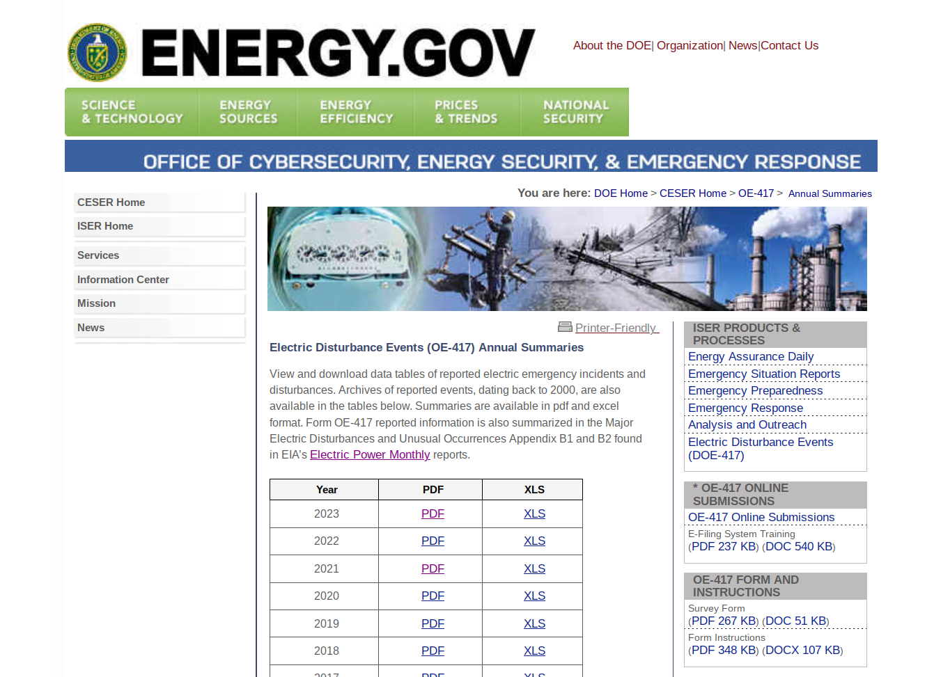
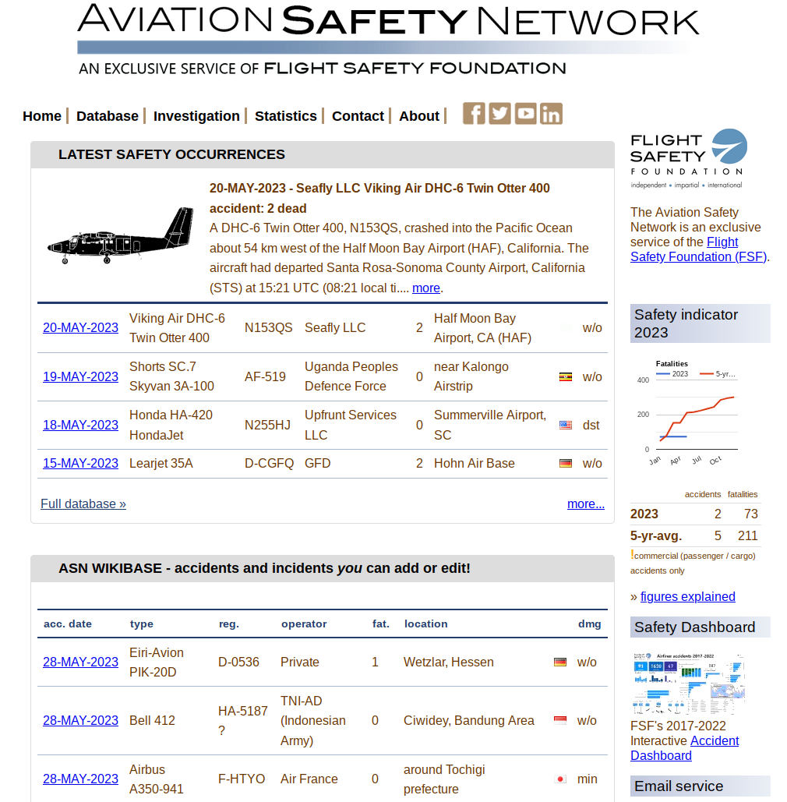
MONITORING (REPORT)
https://www.oe.netl.doe.gov/OE417_annual_summary.aspx
https://www.michigan.gov/mdot/travel/commuters/potholes
https://aviation-safety.net/

Slide 15
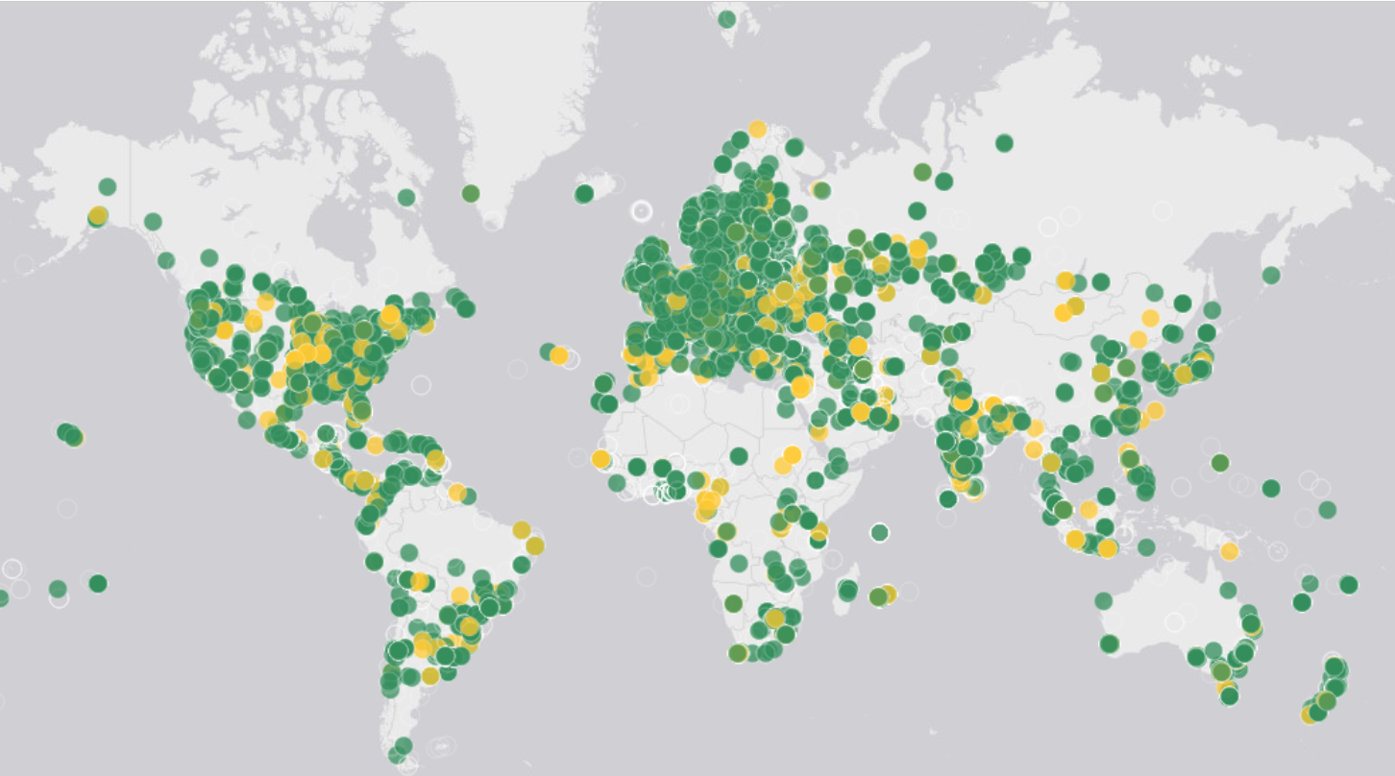
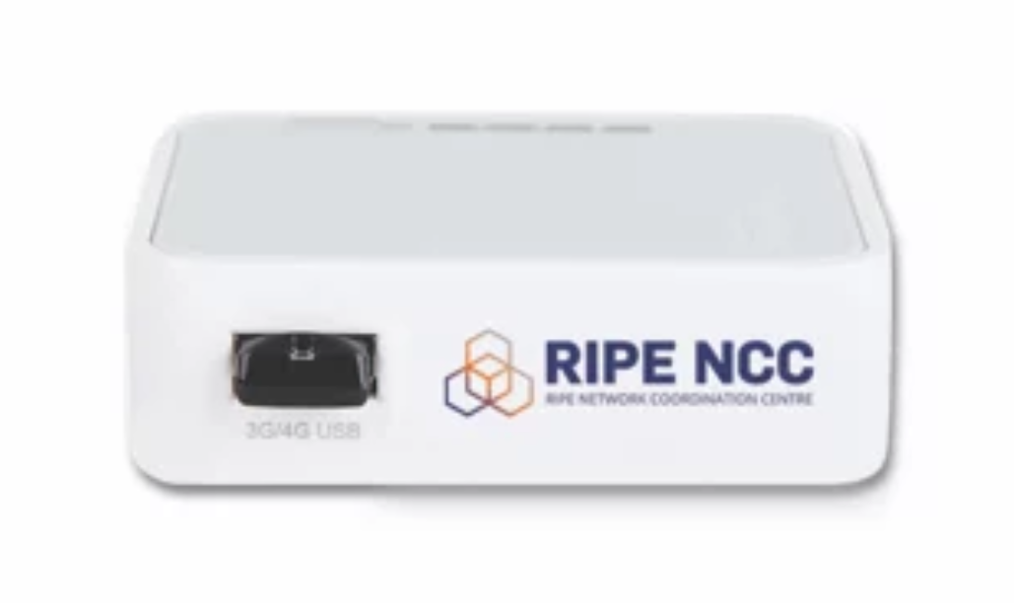
Network delays
Measure AS inter-dependencies
• RIPE Atlas (12k probes)
• IHR monitors latency between Atlas probes and ASes/IXPs/cities/countries found in traceroutes
• Examples: • Impact of subsea cable cut: https://twitter.com/DougMadory/status/1447659550975406094
• Impact of COVID lockdowns: https://ihr.iijlab.net/ihr/en-us/covid19?country=France
• War in Ukraine: https://twitter.com/ihr_alerts/status/1501446740498841604

Slide 16
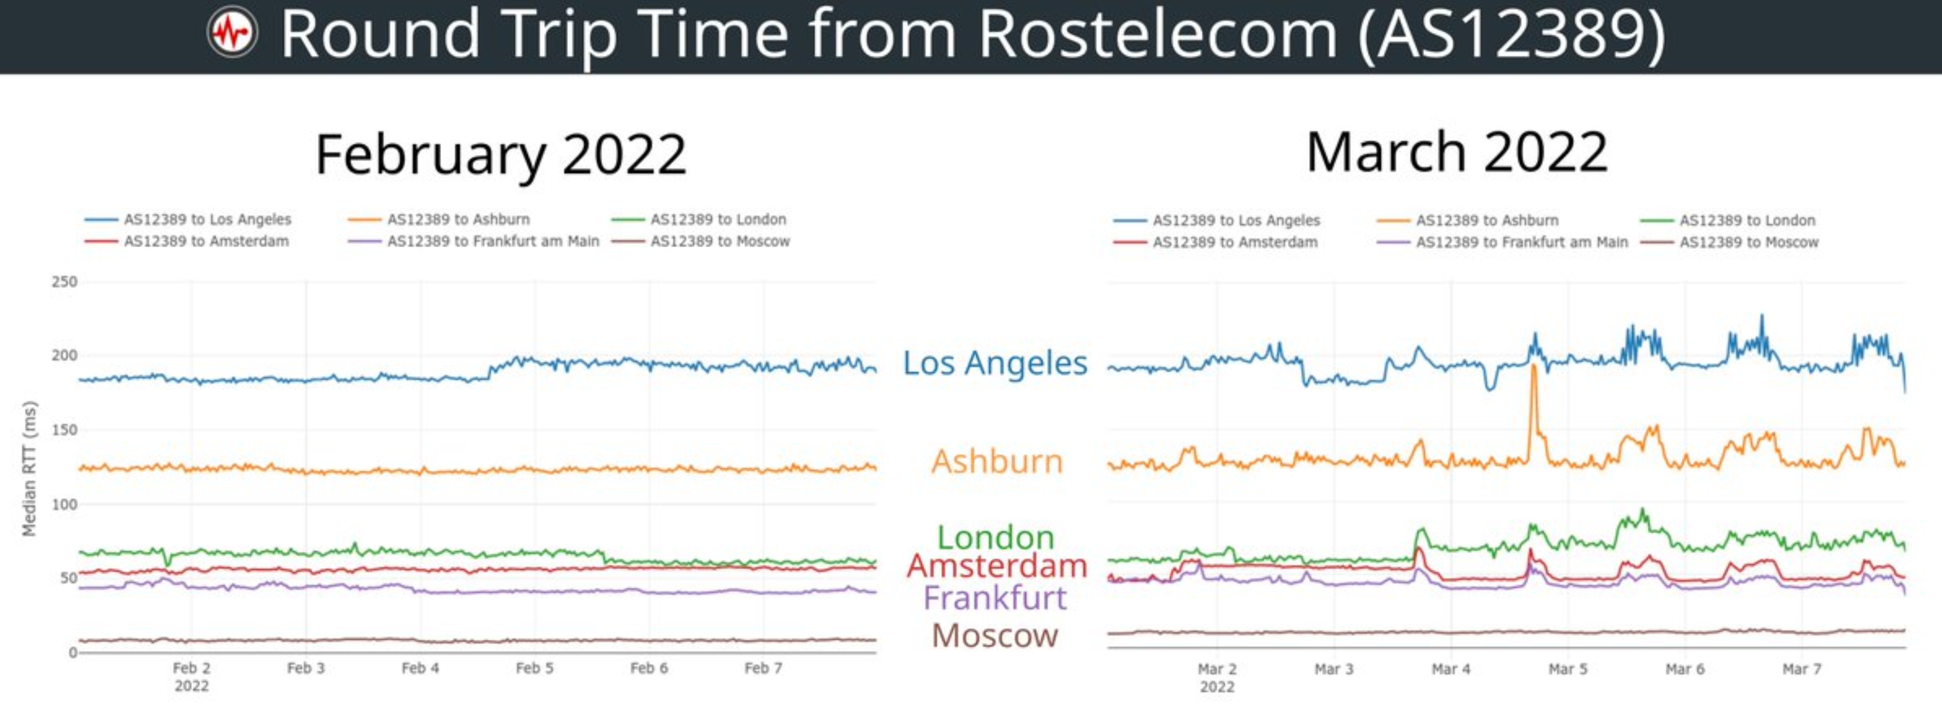
Network congestion

Slide 17
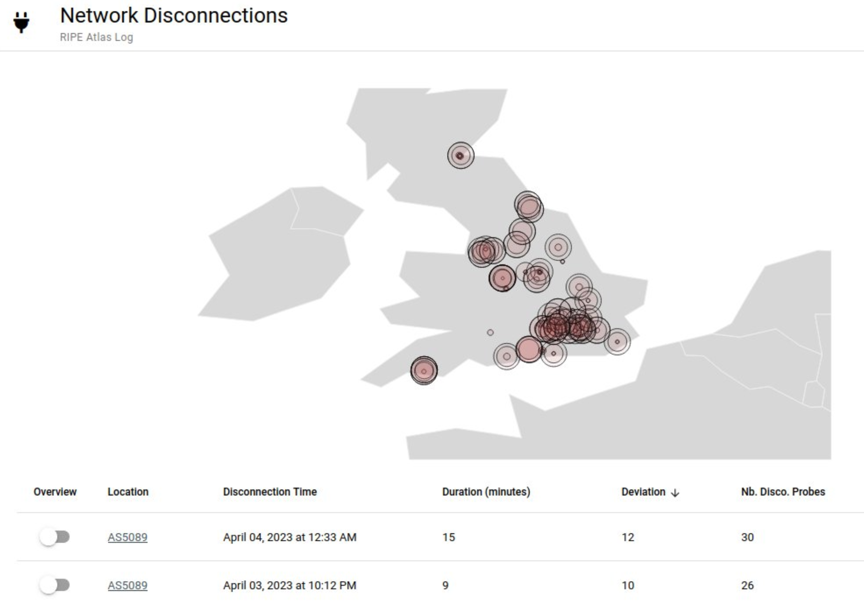
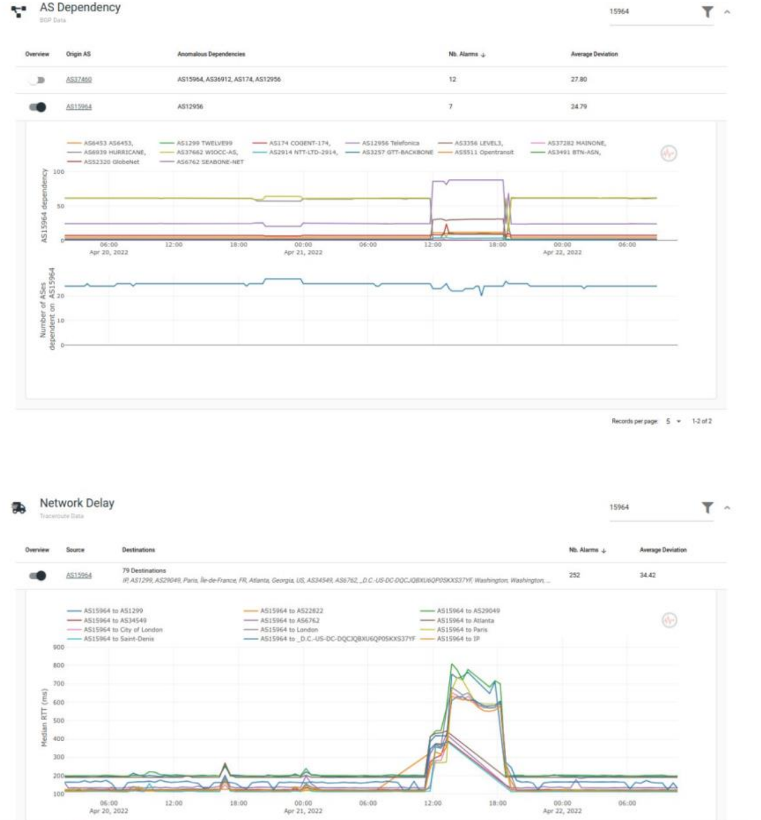
IHR Anomaly detectors
OUTAGE DETECTION
GLOBAL REPORT
• Based on RIPE Atlas
• Detect synchronized Atlas disconnections
• Virgin Media outage: https://twitter.com/ihr_alerts/status/1643226028381446144
• Route, delay changes​
• Near real time analysis

